Slide 1

Customer Shopping Behavior Analysis
Analyzing 3,900 purchases to uncover spending patterns, preferences, and subscription behavior for strategic business decisions.

Slide 2

Project Overview
Goal
Data Source
Uncover insights into spending patterns, customer segments, product preferences, and subscription behavior.
Transactional data from 3,900 purchases across various product categories.
Outcome
Guide strategic business decisions with data-driven insights.

Slide 3

Dataset Summary
Key Features
Data Snapshot
Customer demographics (Age, Gender, Location, Subscription Status)
Rows: 3,900
Purchase details (Item, Category, Amount, Season, Size, Color)
Columns: 18
Shopping behavior (Discount, Promo Code, Previous Purchases, Frequency, Review, Shipping)
Missing Data: 37 values in Review Rating

Slide 4



Exploratory Data Analysis (Python)
Data Loading
Initial Exploration
Missing Data Handling
Column Standardization
Feature Engineering
Database Integration

Slide 5
Data Analysis using SQL
1
2
3
Revenue by Gender
High-Spending Discount Users
Top 5 Products by Rating
Male: $157,890, Female: $75,191
Gloves (3.86), Sandals (3.84), Boots (3.82), Hat (3.80), Skirt (3.78)
Identified 839 customers.
4
5
Shipping Type Comparison
Subscribers vs. Non-Subscribers
Standard: $58.46, Express: $60.48
Subscribers: $62,645 total revenue, Non-Subscribers: $170,436 total revenue.

Slide 6
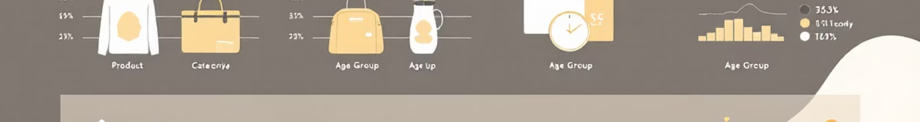
SQL Insights: Product & Customer Focus
Discount-Dependent Products
Hat (50%), Sneakers (49.66%), Coat (49.07%), Sweater (48.17%), Pants (47.37%)
Customer Segmentation
Loyal (3116), Returning (701), New (83)
Repeat Buyers & Subscriptions
Customers with >5 purchases: 958 subscribed, 2518 not subscribed.
Revenue by Age Group
Young Adult: $62,143, Middle-aged: $59,197, Adult: $55,978, Senior: $55,763

Slide 7
Top Products per Category
1
Accessories
Jewelry
171
2
Accessories
Sunglasses
161
3
Accessories
Belt
161
1
Clothing
Blouse
171
2
Clothing
Pants
171
3
Clothing
Shirt
169
1
Footwear
Sandals
160
2
Footwear
Shoes
150
3
Footwear
Sneakers
145
1
Outerwear
Jacket
163
2
Outerwear
Coat
161

Slide 8

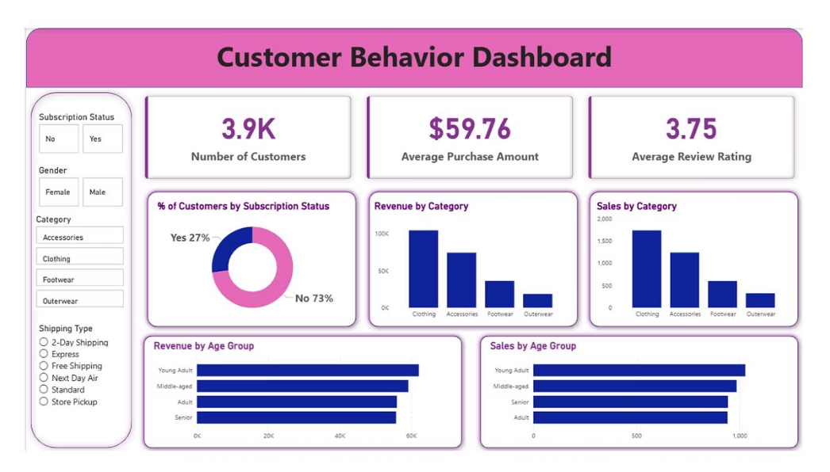
Interactive Dashboard in Power BI
Visualizing insights for easy understanding and decision-making.

Slide 9





Business Recommendations
Boost Subscriptions
Customer Loyalty Programs
Review Discount Policy
Product Positioning
Targeted Marketing

Slide 10

Driving Growth Through Data
Leveraging customer shopping behavior analysis to make informed decisions and drive business growth.

